Slide 1
Advance Database System
Lecture # 3
Department of Computer Science University of Lahore

Slide 2
Hashing Techniques

Slide 3
Review of Previous Lecture
The Storage Hierarchy
Disk Storage Devices
Records
Blocking
Files Of Records
Unordered Files
Ordered Files

Slide 4
Scope of Today Lecture
What Is Hashing
Type Of Hashing
Internal Hashing
External Hashing
Dynamic Hashing
Extendible Hashing

Slide 5
Hashing
Another type of primary file organization is based on hashing, which provides very fast access to records on certain search conditions.
This practice is usually called a hash file.
The search condition must be an equality condition on a single field, called the hash field of the file.
In most cases, the hash field is also a key field of the file.
The idea behind hashing is to provide a function h, called a hash function or randomizing function, that is applied to the hash field value of a record and yields the address of the disk block in which the record is stored.
A search for the record within the block can be carried out in a main memory buffer. For most records, we need only a single-block access to retrieve that record.

Slide 6
Hashing
Hashing is also used as an internal search structure within a program whenever a group of records is accessed exclusively by using the value of one field.
Hashing is also used when a modified record is stored on external files on disk

Slide 7
Internal Hashing
For internal files, hashing is typically implemented as a hash table through the use of an array of records.
Suppose that the array index range is from 0 to M – 1

Slide 8
Internal Hashing
then we have M slots whose addresses correspond to the array indexes.
We choose a hash function that transforms the hash field value into an integer between 0 and M - 1.
One common hash function is the h(K) = K mod M function, which returns the remainder of an integer hash field value K after division by M; this value is then used for the record address.
Noninteger hash field values can be transformed into integers before the mod function is applied.
For character strings, the numeric (ASCII) codes associated with characters can be used in

Slide 9
Example
Five employee records having empid [0,1,2,3, 4] is key field.
Hash function is “mod 5”
The hash table is given.
Key mod 5 = give the array index
Key | record
0
1
2
3
4

Slide 10
Example
Five employee records having empid [0,1,2,3, 4] is key field.
Hash function is “mod 5”
The hash table is given.
Key mod 5 = give the array index
0 mod 5 = 0
then record goes to array index 0.
Key | record
0 | R₀
1
2
3
4

Slide 11
Example
Five employee records having empid [0,1,2,3, 4] is key field.
Hash function is “mod 5”
The hash table is given.
Key mod 5 = give the array index
0 mod 5 = 0
then record goes to array index 0.
1 mod 5 = 1
then record goes to array index 1.
Key | record
0 | R₀
1 | R₁
2
3
4

Slide 12
Example
Five employee records having empid [0,1,2,3, 4] is key field.
Hash function is “mod 5”
The hash table is given.
Key mod 5 = give the array index
0 mod 5 = 0
then record goes to array index 0.
1 mod 5 = 1
then record goes to array index 1.
2 mod 5 = 2
then record goes to array index 2.
Key | record
0 | R₀
1 | R₁
2 | R₂
3
4

Slide 13
Example
Five employee records having empid [0,1,2,3, 4] is key field.
Hash function is “mod 5”
The hash table is given.
Key mod 5 = give the array index
0 mod 5 = 0
then record goes to array index 0.
1 mod 5 = 1
then record goes to array index 1.
2 mod 5 = 2
then record goes to array index 2.
3 mod 5 = 3
then record goes to array index 3.
4 mod 5 = 4
then record goes to array index 4.
Key | record
0 | R₀
1 | R₁
2 | R₂
3 | R₃
4 | R₄

Slide 14
Load Factor
The performance of most collision resolution methods does not depend directly on the number n of stored entries, but depends strongly on the table's load factor, the ratio n/s between n and the size s of its bucket array. With a good hash function, the average lookup cost is nearly constant as the load factor increases from 0 up to 0.7 or so. Beyond that point, the probability of collisions and the cost of handling them increases.
On the other hand, as the load factor approaches zero, the size of the hash table increases with little improvement in the search cost, and memory is wasted.

Slide 15
Problem with Hashing
The problem with most hashing functions is that they do not guarantee that distinct values will hash to distinct addresses
Because the hash field space-the number of possible values a hash field can take-is usually much larger than the address space-the number of available addresses for records.
The hashing function maps the hash field space to the address space.
A collision occurs when the hash field value of a record that is being inserted hashes to an address that already contains a different record.
In this situation, we must insert the new record in some other position, since its hash address is occupied. The process of finding another position is called collision resolution

Slide 16
Example
Five employee records having empid [0,1,2,3, 4] is key field.
Hash function is “mod 5”
The hash table is given.
Key mod 5 = give the array index
0 mod 5 = 0
then record goes to array index 0.
1 mod 5 = 1
then record goes to array index 1.
2 mod 5 = 2
then record goes to array index 2.
3 mod 5 = 3
then record goes to array index 3.
Key | record
0 | R₀
1 | R₁
2 | R₂
3 | R₃
4

Slide 17
Example
Five employee records having empid [0,1,2,3, 4] is key field.
Hash function is “mod 5”
The hash table is given.
Key mod 5 = give the array index
0 mod 5 = 0
then record goes to array index 0.
1 mod 5 = 1
then record goes to array index 1.
2 mod 5 = 2
then record goes to array index 2.
3 mod 5 = 3
then record goes to array index 3.
18 mod 5 = 3
then record goes to array index 3.
Key | record
0 | R₀
1 | R₁
2 | R₂
3 | R₃/R4
4

Slide 18
Collision Resolution
Open addressing: Proceeding from the occupied position specified by the hash address, the program checks the subsequent positions in order until an unused (empty) position is found.

Slide 19
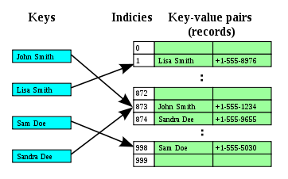
Open addressing

Slide 20
Collision Resolution
Chaining For this method, various overflow locations are kept, usually by extending the array with a number of overflow positions.
In addition, a pointer field is added to each record location.
A collision is resolved by placing the new record in an unused overflow location and setting the pointer of the occupied hash address location to the address of that overflow location.
A linked list of overflow records for each hash address is thus maintained, as shown in Figure

Slide 21
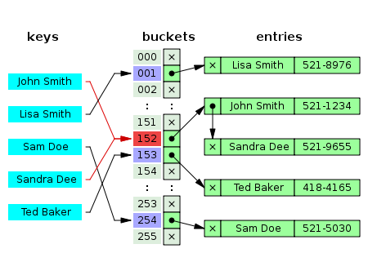

Slide 22
Collision Resolution
Multiple hashing: The program applies a second hash function if the first results in a collision. If another collision results, the program uses open addressing or applies a third hash function and then uses open addressing if necessary.

Slide 23
Issues of Hashing
Each collision resolution method requires its own algorithms for insertion, retrieval, and deletion of records.
The algorithms for chaining are the simplest.
Deletion algorithms for open addressing are rather tricky.
The goal of a good hashing function is to distribute the records uniformly over the address space so as to minimize collisions while not leaving many unused locations.
Simulation and analysis studies have shown that it is usually best to keep a hash table between 70 and 90 percent full so that the number of collisions remains low and we do not waste too much space.
Hence, if we expect to have r records to store in the table, we should choose M locations for the address space such that (r/M) is between 0.7 and 0.9.

Slide 24
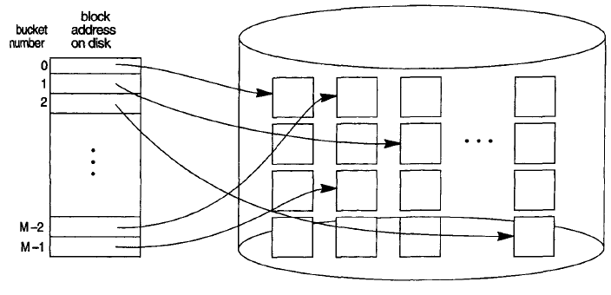
External Hashing
Hashing for disk files is called external hashing.
To suit the characteristics of disk storage, the target address space is made of buckets, each of which holds multiple records.
A bucket is either one disk block or a cluster of blocks.
The hashing function maps a key into a relative bucket number, rather than assign an absolute block address to the bucket.
A table maintained in the file header converts the bucket number into the corresponding disk block address, as illustrated in Figure
The pointers in the linked list should be record pointers, which include both a block address and a relative record position within the block.

Slide 25
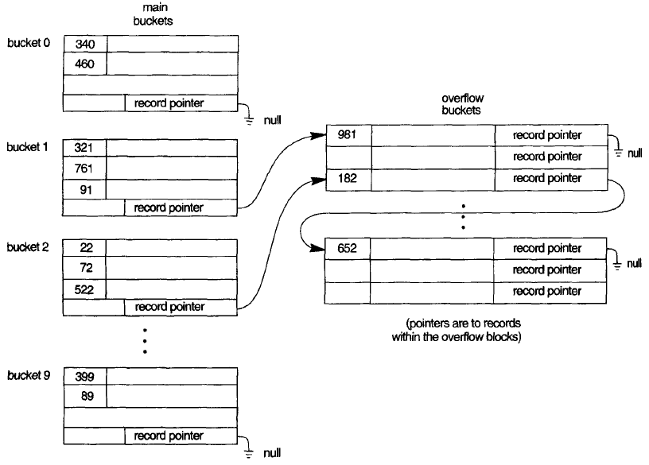
Overflow Handling

Slide 26
Issues of external Hashing
The hashing scheme described is called static hashing because a fixed number of buckets M is allocated.
This can be a serious drawback for dynamic files.
Suppose that we allocate M buckets for the address space and let m be the maximum number of records that can fit in one bucket; then at most (r * M) records will fit in the allocated space.
If the number of records turns out to be substantially fewer than (r * M), we are left with a lot of unused space.
On the other hand, if the number of records increases to substantially more than (m * M), numerous collisions will result and retrieval will be slowed down because of the long lists of overflow records.
In either case, we may have to change the number of blocks M allocated and then use a new hashing function (based on the new value of M) to redistribute the records.
These reorganizations can be quite time consuming for large files.

Slide 27
Issues of external Hashing
When using external hashing, searching for a record given a value of some field other than the hash field is as expensive as in the case of an unordered file.
Modifying a record's field value depends on two factors: (1) the search condition to locate the record and (2) the field to be modified.
If the search condition is an equality comparison on the hash field, we can locate the record efficiently by using the hashing function; otherwise, we must do a linear search.
A nonhash field can be modified by changing the record and rewriting it in the same bucket.
Modifying the hash field means that the record can move to another bucket, which requires deletion of the old record followed by insertion of the modified record.

Slide 28
Dynamic Hashing
A major drawback of the static hashing scheme just discussed is that the hash address space is fixed.
Hence, it is difficult to expand or shrink the file dynamically.
The first scheme-extendible hashing-stores an access structure in addition to the file, and hence is somewhat similar to indexing.
The main difference is that the access structure is based on the values that result after application of the hash function to the search field.
In indexing, the access structure is based on the values of the search field itself. The second technique, called linear hashing, does not require additional access structures.

Slide 29
Dynamic Hashing
These hashing schemes take advantage of the fact that the result of applying a hashing function is a nonnegative integer and hence can be represented as a binary number.
The access structure is built on the binary representation of the hashing function result, which is a string of bits.
We call this the hash value of a record.
Records are distributed among buckets based on the values of the leading bits in their hash values

Slide 30
Dynamic Hashing
In extendible hashing, a type of directory n array of 2^{d} bucket addresses is maintained, where d is called the global depth of the directory.
The integer value corresponding to the first (high-order) d bits of a hash value is used as an index to the array to determine a directory entry, and the address in that entry determines the bucket in which the corresponding records are stored.
However, there does not have to be a distinct bucket for each of the 2^{d} directory locations.
Several directory locations with the same first d' bits for their hash values may contain the same bucket address if all the records that hash to these locations fit in a single bucket.
A local depth d‘ stored with each bucket specifies the number of bits on which the bucket contents are based. Figure shows a directory with global depth d = 3.

Slide 31
Dynamic Hashing

Slide 32
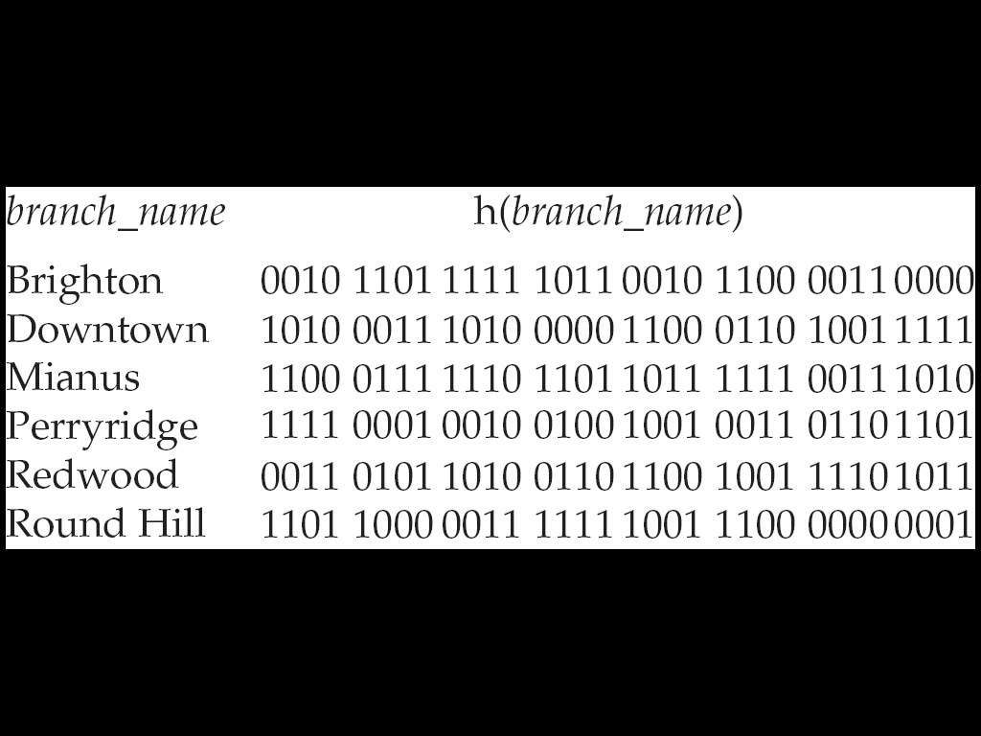
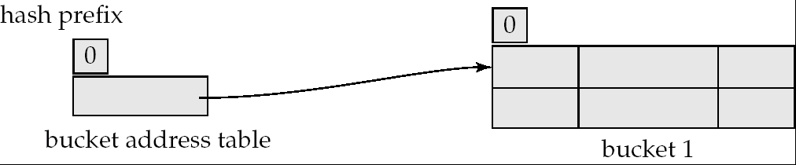
Use of Extendable Hash Structure: Example
Initial Hash structure, bucket size = 2

Slide 33
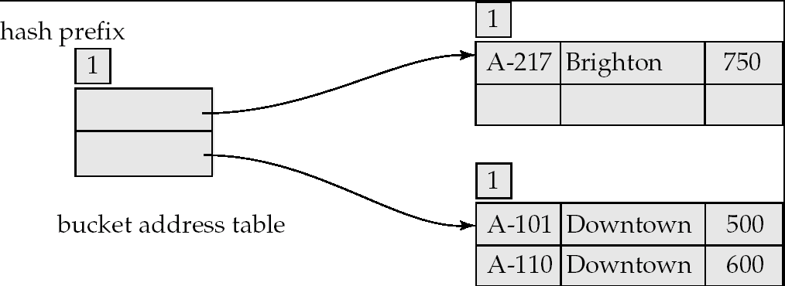
Example (Cont.)
Hash structure after insertion of one Brighton and two Downtown records

Slide 34
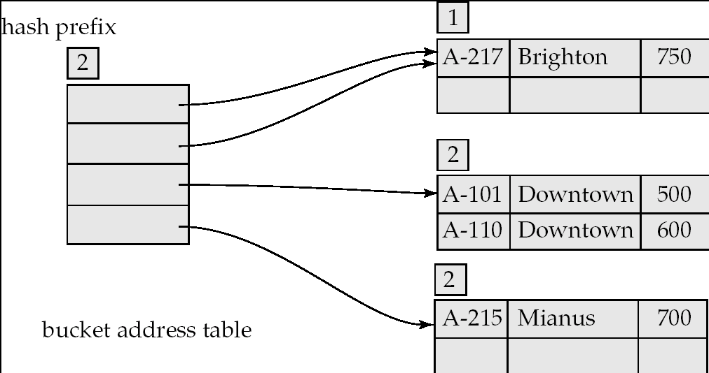
Example (Cont.)
Hash structure after insertion of Mianus record

Slide 35
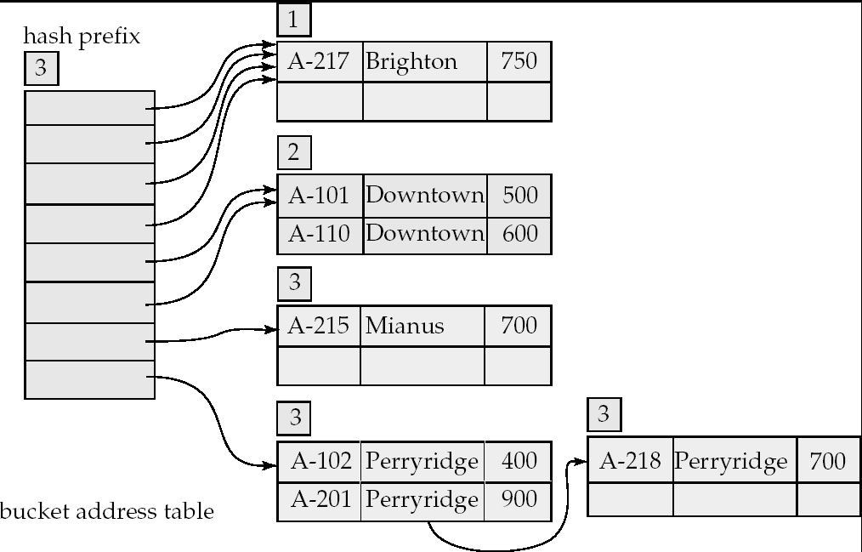
Example (Cont.)
Hash structure after insertion of three Perryridge records

Slide 36
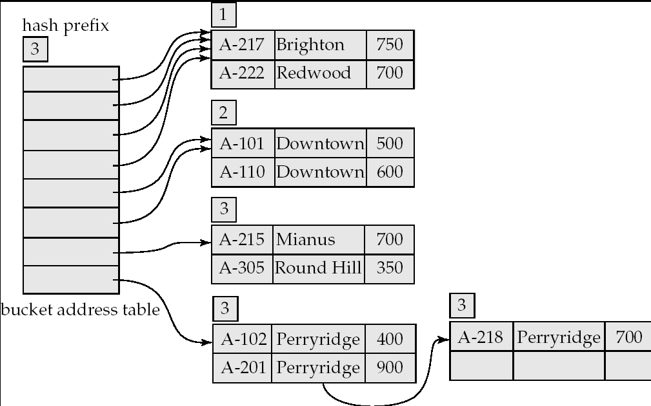
Example (Cont.)
Hash structure after insertion of Redwood and Round Hill records
October 17, 2012

Slide 37
Example
LOCAL DEPTH
2
Bucket A
Insert 20,
Binary is = 10100
GLOBAL DEPTH
4*
12*
32*
16*
2
2
00
1*
5*
21*
13*
Bucket B
Record goes to bucket A, here is collision.
Now we perform two steps.
If the local depth of collision bucket is equal to global depth of directory then double the directory size, and spilt the bucket as well.
01
10
2
10*
Bucket C
11
DIRECTORY
2
15*
7*
19*
Bucket D

Slide 38
Example
LOCAL DEPTH
2
3
Bucket A
LOCAL DEPTH
GLOBAL DEPTH
32*
16*
32*
16*
Bucket A
GLOBAL DEPTH
2
2
3
2
00
1*
5*
21*
13*
Bucket B
1*
5*
21*
13*
000
Bucket B
01
001
10
2
010
2
11
10*
Bucket C
011
10*
Bucket C
2
100
DIRECTORY
Bucket D
101
2
15*
7*
19*
15*
7*
19*
Bucket D
110
2
111
Bucket A2
3
4*
12*
20*
(`split image'
DIRECTORY
4*
12*
20*
Bucket A2
of Bucket A)
(`split image'
of Bucket A)

Slide 39
Review of Lecture
What Is Hashing
Type Of Hashing
Internal Hashing
External Hashing
Dynamic Hashing
Extendible Hashing
Linear Hashing

Slide 40
Thanks

