Slide 1
Advance Database System
Lecture # 4
Department of Computer Science University of Lahore

Slide 2
Review of Previous Lecture
What Is Hashing
Type Of Hashing
Internal Hashing
External Hashing
Dynamic Hashing
Extendible Hashing

Slide 3
Scope of Today Lecture
Index Structure for Files
Types of Indexing
  Primary indexing
  Clustering indexing
  Secondary indexing

Slide 4
Index Structure for Files
In this lecture, we assume that a file already exists with some primary organization such as the unordered, ordered, or hashed organizations that were described in Chapter 13.
We will describe additional access structures called indexes, which are used to speed up the retrieval of records in response to certain search conditions.
The index structures typically provide secondary access paths, which provide alternative ways of accessing the records without affecting the physical placement of records on disk.
They enable efficient access to records based on the indexing fields that are used to construct the index.
Basically, any field of the file can be used to create an index and multiple indexes on different fields can be constructed on the same file.

Slide 5
Index Structure for Files
A variety of indexes are possible;
Each of them uses a particular data structure to speed up the search.
To find a record or records in the file based on a certain selection on an indexing field, one has to initially access the index, which points to one or more blocks in the file where the required records are located.
The most prevalent types of indexes are based on ordered files (single level indexes) and tree data structures (multilevel indexes, B+-trees).
[Today We Will Discuss Signal Level Ordered Indexing]

Slide 6
Signal Level Ordered Indexing
The idea behind an ordered index access structure is similar to that behind the index used in a textbook, which lists important terms at the end of the book in alphabetical order along with a list of page numbers where the term appears in the book.
We can search an index to find a list of addresses-page numbers in this case-and use these addresses to locate a term in the textbook by searching the specified pages.
The alternative, if no other guidance is given, would be to sift slowly through the whole textbook word by word to find the term we are interested in; this corresponds to doing a linear search on a file.
Of course, most books do have additional information, such as chapter and section titles, that can help us find a term without having to search through the whole book.
However, the index is the only exact indication of where each term occurs in the book.

Slide 7
Signal Level Ordered Indexing
For a file with a given record structure consisting of several fields (or attributes), an index access structure is usually defined on a single field of a file, called an indexing field (or indexing attribute).
The index typically stores each value of the index field along with a list of pointers to all disk blocks that contain records with that field value.
The values in the index are ordered so that we can do a binary search on the index.
The index file is much smaller than the data file, so searching the index using a binary search is reasonably efficient.
Multilevel indexing (see Section 14.2) does away with the need for a binary search at the expense of creating indexes to the index itself.

Slide 8
Signal Level Ordered Indexing
There are several types of ordered indexes.
A primary index is specified on the ordering key field of an ordered file of records.
Recall from Section 13.7 that an ordering key field is used to physically order the file records on disk, and every record has a unique value for that field.
If the ordering field is not a key field-that is, if numerous records in the file can have the same value for the ordering field-another type of index, called a clustering index, can be used.
Notice that a file can have at most one physical ordering field, so it can have at most one primary index or one clustering index, but not both.
A third type of index, called a secondary index, can be specified on any nonordering field of a file.
A file can have several secondary indexes in addition to its primary access method. In the next three subsections we discuss these three types of single-level indexes.

Slide 9
Primary Index
A primary index is an ordered file whose records are of fixed length with two fields.
The first field is of the same data type as the ordering key field-called the primary key-of the data file, and the second field is a pointer to a disk block (a block address).
There is one index entry (or index record) in the index file for each block in the data file.
Each index entry has the value of the primary key field for the first record in a block and a pointer to that block as its two field values. We will refer to the two field values of index entry i as <Ku), P(i)>.

Slide 10
How to Create Primary Index
To create a primary index on the ordered file shown in Figure 13.7, we use the NAME field as primary key, because that is the ordering key field of the file (assuming that each value of NAME is unique). Each entry in the index has a NAME value and a pointer.

Slide 11
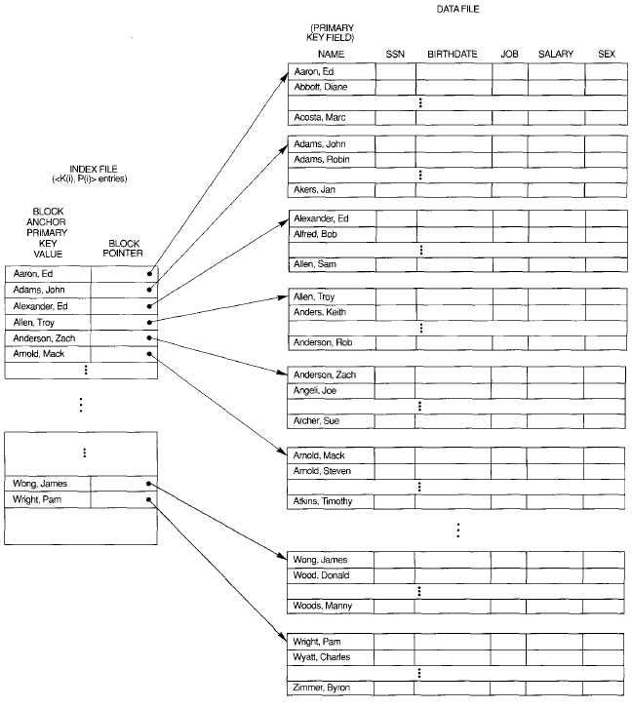
How to Create Primary Index

Slide 12
Important Points in Primary Index
The total number of entries in the index is the same as the number of disk blocks in the ordered data file

Slide 13
Important Points in Primary Index
The first record in each block of the data file is called the anchor record of the block, or simply the block anchor.

Slide 14
Categories of Indexing
Indexes can also be characterized as dense or sparse.
A sparse (or nondense) index, on the other hand, has index entries for only some of the search values
A dense index has an index entry for every search key value (and hence every record) in the data file.
A primary index is hence a nondense (sparse) index, since it includes an entry for each disk block of the data file and the keys of its anchor record rather than for every search value (or every record).

Slide 15
Important Points in Primary Index
The index file for a primary index needs substantially fewer blocks than does the data file, for two reasons.
First, there are fewer index entries than there are records in the data file.
Second, each index entry is typically smaller in size than a data record because it has only two fields.
consequently, more index entries than data records can fit in one block.
A binary search on the index file hence requires fewer block accesses than a binary search on the data file.

Slide 16
Example
Ordered file with r = 30,000
Block size B = 1024 bytes.
File records are of fixed size and are unspanned, with
Record length R = 100 bytes.

Slide 17
Example of Primary Index
Ordered file with r = 30,000
Block size B = 1024 bytes.
File records are of fixed size and are unspanned, with
Record length R = 100 bytes.
Oreder key field V , Block Pointer P
Total Block access = 1+6 = 7

Slide 18
Disadvantages of Primary Index
A major problem with a primary index as with any ordered file is insertion and deletion of records.
With a primary index, the problem is compounded because, if we attempt to insert a record in its correct position in the data file, we have to not only move records to make space for the new record but also change some index entries, since moving records will change the anchor records of some blocks.
Using an unordered overflow file, as discussed in Section 13.7, can reduce this problem.

Slide 19
Example of Primary Index
The total number of entries in the index is the same as the number of disk blocks in the ordered data file

Slide 20
Break for 10 min.

Slide 21
Clustering Indexing
If records of a file are physically ordered on a nonkey field-which does not have a distinct value for each record-that field is called the clustering field.
We can create a different type of index, called a clustering index, to speed up retrieval of records that have the same value for the clustering field.
This differs from a primary index, which requires that the ordering field of the data file have a distinct value for each record.

Slide 22
Clustering Indexing
A clustering index is also an ordered file with two fields; the first field is of the same type as the clustering field of the data file, and the second field is a block pointer.
There is one entry in the clustering index for each distinct value of the clustering field,
Containing the value and a pointer to the first block in the data file that has a record with that value for its clustering field.
Nondense indexing

Slide 23
Clustering Indexing
Notice that record insertion and deletion still cause problems, because the data records are physically ordered.
Add new record having department # 2.
We will have to shift the half of file on the average.

Slide 24
Clustering Indexing
Ordered file with r = 30,000
Block size B = 1024 bytes.
File records are of fixed size and are unspanned, with
Record length R = 100 bytes.
Total Block access = 1+6 = 7
But this is not total cost

Slide 25
Clustering index with a separate block cluster for each group of records that share the same value for the clustering field.

Slide 26
Secondary Index
A secondary index provides a secondary means of accessing a file for which some primary access already exists.
The secondary index may be on a field which is a candidate key and has a unique value in every record, or a nonkey with duplicate values.
The index is an ordered file with two fields. The first field is of the same data type as some nonordering field of the data file that is an indexing field.
The second field is either a block pointer or a record pointer. There can be many secondary indexes (and hence, indexing fields) for the same file.

Slide 27
Secondary Index
We first consider a secondary index access structure on a key field that has a distinct value for every record.
Such a field is sometimes called a secondary key.
In this case there is one index entry for each record in the data file, which contains the value of the secondary key for the record and a pointer either to the block in which the record is stored or to the record itself.
Hence, such an index is dense.

Slide 28
Secondary Index
We again refer to the two field values of index entry i as <K(i), P(i».
The entries are ordered by value of K(i), so we can perform a binary search. Because the records of the data file are not physically ordered by values of the secondary key field, we cannot use block anchors.
That is why an index entry is created for each record in the data file, rather than for each block, as in the case of a primary index.
Figure illustrates a secondary index in which the pointers P(i) in the index entries are block pointers, not record pointers.
Once the appropriate block is transferred to main memory, a search for the desired record within the block can be carried out.

Slide 29
Example is there any improvement?
If secondary index is not available the b/2= 3000/2= 1500
Ordered file with r = 30,000
Block size B = 1024 bytes.
File records are of fixed size and are unspanned, with
Record length R = 100 bytes.
Total Block access = 9 + 1= 10

Slide 30
Secondary Indexing
Secondary index can generated on nonkey field.
We have three options
  Dense Indexing
  Variable Length index field <K(i),<p₁,p₂,…p_{n}>>
  Indirection

Slide 31
Indirection Implementation

Slide 32
Review of Lecture
What is Indexing
  Primary indexing
  Clustering indexing
  Secondary indexing

Slide 33
Thanks

