Slide 1
Advance Database System
Department of Computer Science University of Lahore

Slide 2
Scope of Lecture
Dynamically Multi Level Indexing using Trees
What is tree
  B-Tree
  B+ Tree

Slide 3
DYNAMIC MULTILEVEL INDEXES USING
B-TREES AND B+-TREES
B-trees and B+-trees are special cases of the well-known tree data structure.
We introduce very briefly the terminology used in discussing tree data structures.
A tree is formed of nodes.
Each node in the tree, except for a special node called the root, has one parent node and several-zero or more--child nodes.
The root node has no parent.
A node that does not have any child nodes is called a leaf node; a nonleaf node is called an internal node.
The level of a node is always one more than the level of its parent, with the level of the root node being zeros.
A subtree of a node consists of that node and all its descendant nodes-its child nodes, the child nodes of its child nodes, and so on.

Slide 4
Tree Structure

Slide 5
Multi-Level Indexes …
Because a single-level index is an ordered file, we can create a primary index to the index itself ; in this case, the original index file is called the first-level index and the index to the index is called the second-level index.
We can repeat the process, creating a third, fourth, ..., top level until all entries of the top level fit in one disk block
A multi-level index can be created for any type of first-level index (primary, secondary, clustering) as long as the first-level index consists of more than one disk block
Such a multi-level index is a form of search tree ; however, insertion and deletion of new index entries is a severe problem because every level of the index is an ordered file.
Notes:
Soldiers and Officers

Slide 6
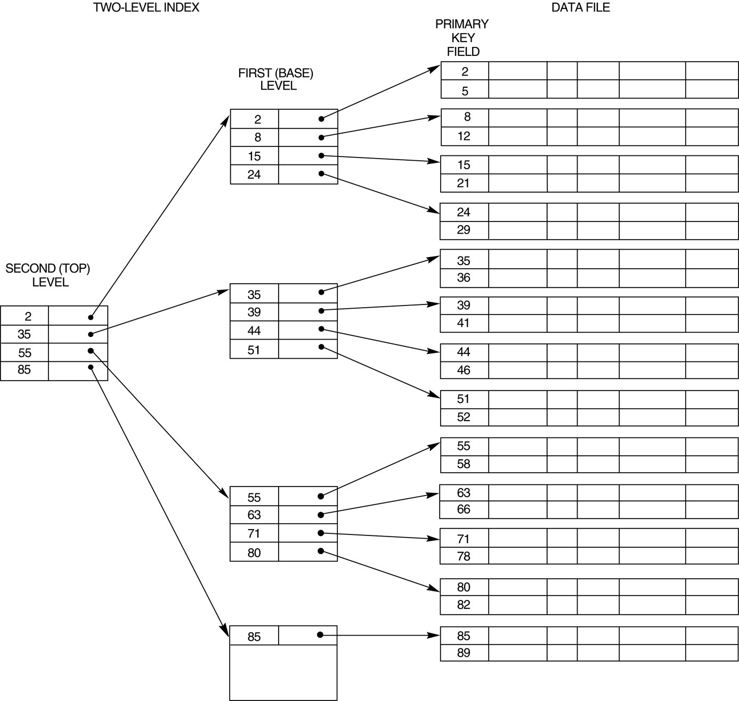
A two-level primary indexing

Slide 7
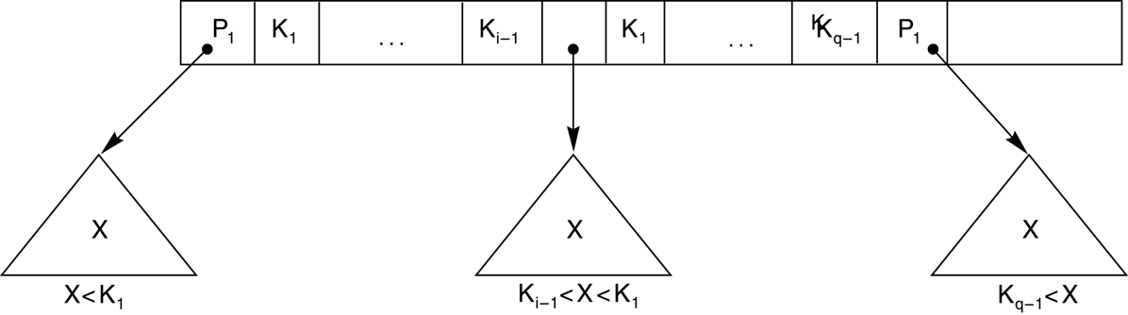
A node in a search tree with pointers to subtrees below it.

Slide 8
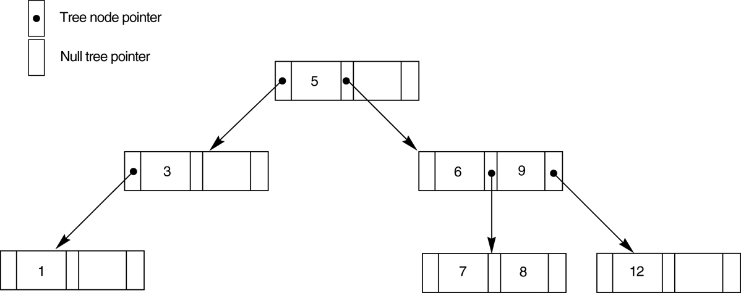
A search tree Example

Slide 9
Problems with Trees
Balancing
  meaning that all of its leaf nodes are at the same level
Deletion and Insertion of records

Slide 10
How to Overcome
[The B-tree addresses both of these problems by specifying additional constraints on the search tree.]

Slide 11
B-Tree
The B-tree has additional constraints that ensure that the tree is always balanced and that the space wasted by deletion, if any, never becomes excessive.
a B-Tree of order p, when used as an access structure on a key field to search for records in a data file, can be defined as follows:

Slide 12
B-Tree Constraints
1. Each internal node in the B-tree (Figure 14.10a) is of the form
<P_{I} ,<K_{I}, Pr_{I}>, P₂, <K₂, Pr₂>, .. , <K_{q-I} ,Pr_{q-I}>, P_{q}>
2. Within each node, K_{I} < K₂< ... < K_{q-I}
3. Each node has at most p tree pointers.
4. Each node, except the root and leaf nodes, has at least ceiling(p/2) tree pointers. The root node has at least two tree pointers unless it is the only node in the tree.
5. A node with q tree pointers, q <= p, has q - 1 search key field values (and hence has q - 1 data pointers).
6. All leaf nodes are at the same level. Leaf nodes have the same structure as internal nodes except that all of their tree pointers P, are null.

Slide 13
B-tree structures

Slide 14
Example of B-Tree
Construct B-Tree for given values
8, 5, 1, 7, 2, 12, 9, 6
Tree Order p = 3

Slide 15
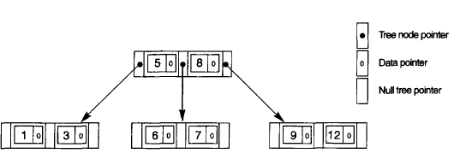

Slide 16
B-Tree Order
Don’t know order of the B-Tree then
B = 512 bytes
Search Field V = 9 bytes
Record Pointer Pr = 7 bytes
Block Pointer P = 6 bytes

Slide 17
Levels of B-Tree
Suppose that the search field of Example 4 is a nonordering key field, and we construct a B-tree on this field. Assume that each node of the B-tree is 69 percent full. Each node, on the average, will have p * 0.69 = 23 * 0.69 or approximately 16 pointers and, hence, 15 search key field values. The average fan-out fo =16. We can start at the root and see how many values and pointers can exist, on the average, at each subsequent level:

Slide 18
Levels of B-Tree
How many level enough
Root | 1 node | 15 entries | 16 pointers
Level 1
Level 2
Level 3

Slide 19
Levels of B-Tree
How many level enough
Root | 1 node | 15 entries | 16 pointers
Level 1 | 16 nodes
Level 2
Level 3

Slide 20
Levels of B-Tree
How many level enough
Root | 1 node | 15 entries | 16 pointers
Level 1 | 16 nodes | 240 entries
Level 2
Level 3

Slide 21
Levels of B-Tree
How many level enough
Root | 1 node | 15 entries | 16 pointers
Level 1 | 16 nodes | 240 entries | 256 pointers
Level 2
Level 3

Slide 22
Levels of B-Tree
How many level enough
Root | 1 node | 15 entries | 16 pointers
Level 1 | 16 nodes | 240 entries | 256 pointers
Level 2 | 256 nodes
Level 3

Slide 23
Levels of B-Tree
How many level enough
Root | 1 node | 15 entries | 16 pointers
Level 1 | 16 nodes | 240 entries | 256 pointers
Level 2 | 256 nodes | 3840 entries
Level 3

Slide 24
Levels of B-Tree
How many level enough
Root | 1 node | 15 entries | 16 pointers
Level 1 | 16 nodes | 240 entries | 256 pointers
Level 2 | 256 nodes | 3840 entries | 4096 pointers
Level 3

Slide 25
Levels of B-Tree
How many level enough
Root | 1 node | 15 entries | 16 pointers
Level 1 | 16 nodes | 240 entries | 256 pointers
Level 2 | 256 nodes | 3840 entries | 4096 pointers
Level 3 | 4096 nodes | 61440 entries

Slide 26
Deletion from B-Tree
Deletion H

Slide 27
Delete T
Since T is not in a leaf, we find its successor (the next item in
ascending order), which happens to be W, and move W up to replace the T.

Slide 28
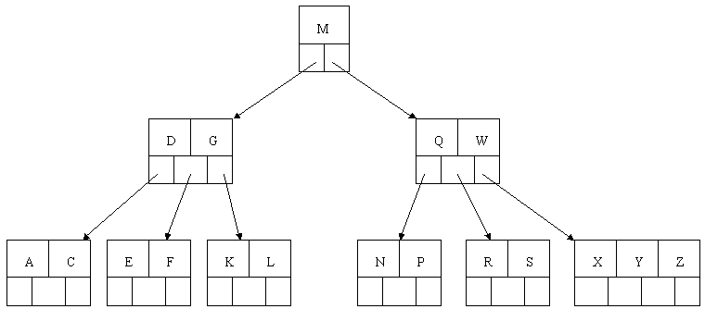
Delete R
When we remove R. promote element from it its one sibling if they have more than one element then minimum no. and depromote the who pointing the element

Slide 29
Delete E
Now we do not promote its sibling element because all sibling have not more then minimum no. of elements. So we combine the node where deletion occur and with any of its sibling node plus its predecessor element

Slide 30
But Again Problem at level 1
Combine level 0 and 1 again

Slide 31
Finally the B-Tree

Slide 32
Another Example
Delete C
Find its successor which is D then promote D in place of C

Slide 33
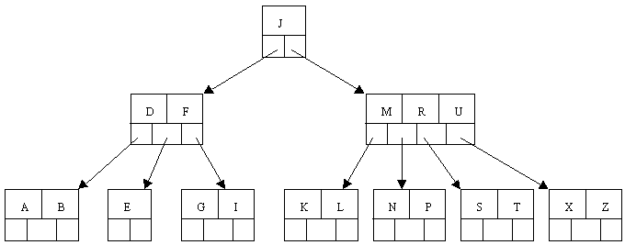
Problem

Slide 34
Problem

Slide 35
Problem

Slide 36
B+-Tree
Most implementations of a dynamic multilevel index use a variation of the B-tree data structure called a B+-tree.
In a B-tree, every value of the search field appears once at some level in the tree, along with a data pointer.
In a B+-tree, data pointers are stored only at the leaf nodes of the tree; hence, the structure of leaf nodes differs from the structure of internal nodes.

Slide 37
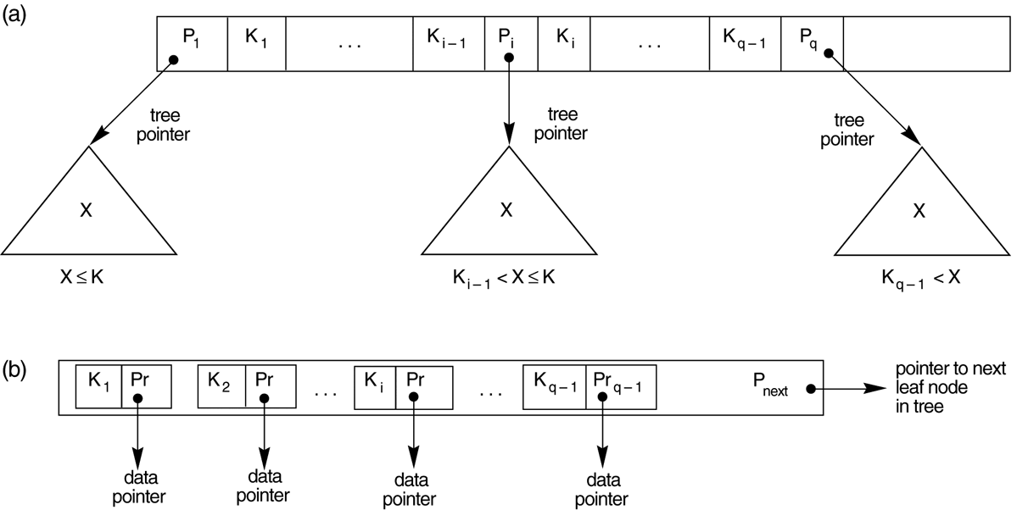
B+-Tree

Slide 38
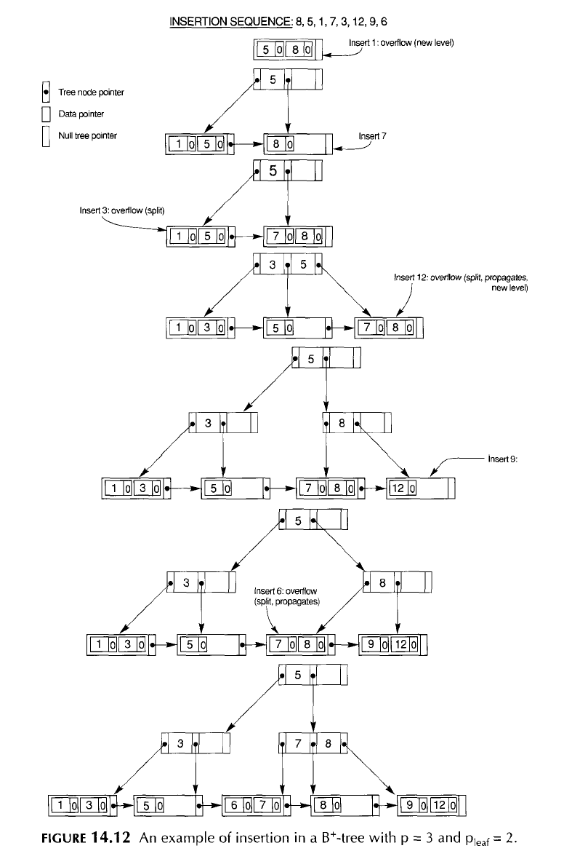

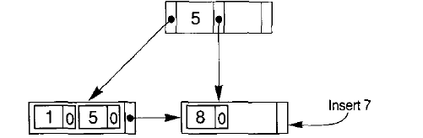
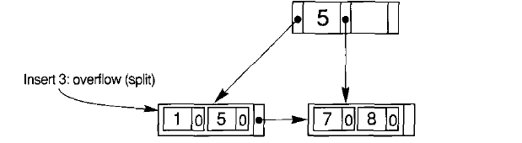

Slide 39
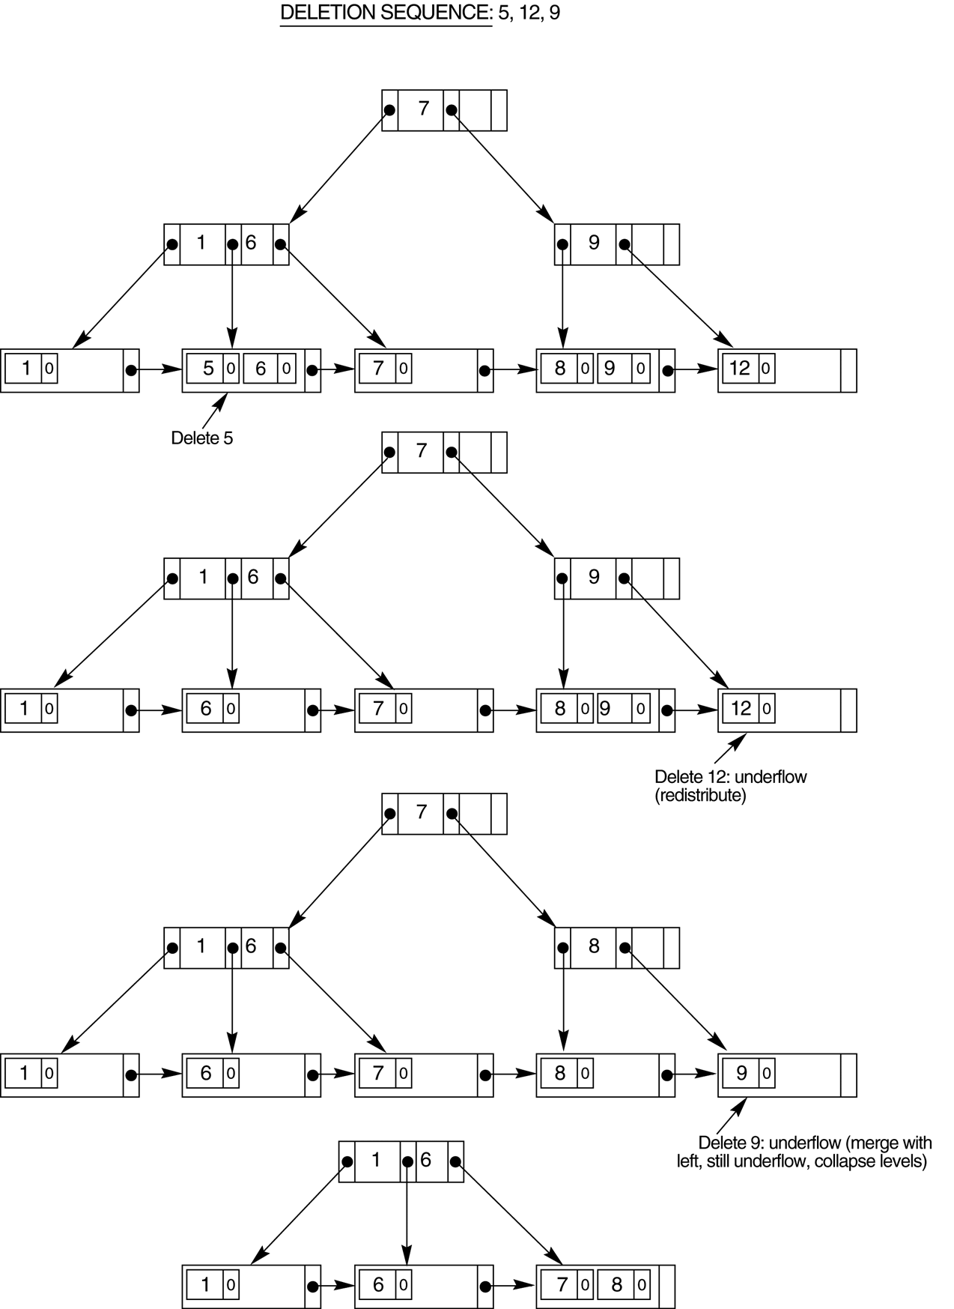

Slide 40
Thanks

