Slide 1
Advance Database Systems
Query Optimization Ch 15
Department of Computer Science
The University of Lahore
Notes:
1

Slide 2
Algorithms for Query Processing and Optimization

Slide 3
Scope of Lecturer
Introduction to Query Processing
Translating SQL Queries into Relational Algebra
Algorithms for External Sorting
Algorithms for SELECT and JOIN Operations
Algorithms for PROJECT and SET Operations
Implementing Aggregate Operations and Outer Joins
Combining Operations using Pipelining

Slide 4
Introduction to Query Processing
Query optimization: the process of choosing a suitable execution strategy for processing a query.
Two internal representations of a query
Query TreeAn internal representation of the query is then created, usually as a tree data structure called a query tree.
Query Graph It is also possible to represent the query using a graph data structure called a query graph

Slide 5
Introduction to Query Processing

Slide 6
Translating SQL Queries into Relational Algebra
Query block: the basic unit that can be translated into the algebraic operators and optimized.
A query block contains a single SELECT-FROM-WHERE expression, as well as GROUP BY and HAVING clause if these are part of the block.
Nested queries within a query are identified as separate query blocks.
Aggregate operators in SQL must be included in the extended algebra.

Slide 7
Correlated vs. Noncorrelated Subqueries
Noncorrelated subqueries:
  Do not depend on data from the outer query
  Execute once for the entire outer query
Correlated subqueries:
  Make use of data from the outer query
  Execute once for each row of the outer query
  Can use the EXISTS operator

Slide 8
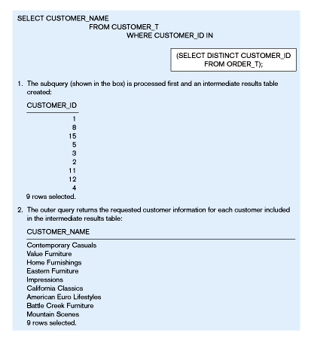
Figure
Processing a noncorrelated subquery
No reference to data in outer query, so subquery executes once only
The subquery executes and returns the customer IDs from the ORDER_T table
The outer query on the results of the subquery
These are the only customers that have IDs in the ORDER_T table

Slide 9
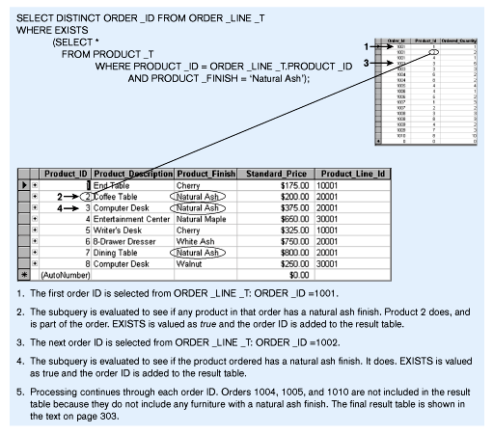
Figure Processing a correlated subquery
Subquery refers to outer-query data, so executes once for each row of outer query
Note: only the orders that involve products with Natural Ash will be included in the final results

Slide 10
Translating SQL Queries into Relational Algebra
SELECT LNAME, FNAME
FROM EMPLOYEE
WHERE SALARY > ( SELECT MAX (SALARY)
FROM EMPLOYEE
WHERE DNO = 5);
SELECT LNAME, FNAME
FROM EMPLOYEE
WHERE SALARY > C
SELECT MAX (SALARY)
FROM EMPLOYEE
WHERE DNO = 5
π_{LNAME, FNAME} (σ_{SALARY>C}(EMPLOYEE))
ℱ_{MAX SALARY} (σ_{DNO=5} (EMPLOYEE))

Slide 11
Algorithms for External Sorting
External sorting: refers to sorting algorithms that are suitable for large files of records stored on disk that do not fit entirely in main memory, such as most database files.
Sort-Merge strategy: starts by sorting small subfiles (runs) of the main file and then merges the sorted runs, creating larger sorted subfiles that are merged in turn.

Slide 12
3,4
6,2
9,4
8,7
5,6
3,1
2
Input file
PASS 0
3,4
2,6
4,9
7,8
5,6
1,3
2
PASS 1
2,3
4,7
1,3
4,6
8,9
5,6
2
PASS 2
2,3
4,4
1,2
6,7
3,5
8,9
6
PASS 3
1,2
2,3
3,4
4,5
6,6
7,8
9

Slide 13
External Sorting
File having blocks, b
Available buffer, n_{B}
No. of initial runs, n_{R}= ceiling (b/n_{B})
Sorting Phase
Merging Phase
Degree of Merging d_{M} min(nB -1 , nR)
No. of Passes, Ceiling (logd_{M}(n_{R}))

Slide 14
Example
File having blocks, b = 1024
Available buffer, nB = 5
No. of initial runs, n_{R} = ?
Degree of Merging d_{M} = ?
No. of Passes = ?

Slide 15
Example
File having blocks, b = 1024
Available buffer, nB = 5
No. of initial runs, n_{R} = ceil (1024 / 5 )
Degree of Merging d_{M} = ?
No. of Passes = ?

Slide 16
3. Algorithms for SELECT and JOIN Operations (1)
Implementing the SELECT Operation:
Examples:
(OP1): σ _{SSN='123456789'} (EMPLOYEE)
(OP2): σ _{DNUMBER>5}(DEPARTMENT)
(OP3): σ _{DNO=5}(EMPLOYEE)
(OP4): σ DNO=5 AND SALARY>30000 AND SEX=F(EMPLOYEE)
(OP5): σ _{ESSN=123456789 AND PNO=10}(WORKS_ON)

Slide 17
Algorithms for SELECT and JOIN Operations
Implementing the SELECT Operation
Search Methods for Simple Selection:
S1. Linear search (brute force): Retrieve every record in the file, and test whether its attribute values satisfy the selection condition.
S2. Binary search: If the selection condition involves an equality comparison on a key attribute on which the file is ordered, binary search (which is more efficient than linear search) can be used. (See OP1).
S3. Using a primary index or hash key to retrieve a single record: If the selection condition involves an equality comparison on a key attribute with a primary index (or a hash key), use the primary index (or the hash key) to retrieve the record.

Slide 18
Algorithms for SELECT and JOIN Operations
Implementing the SELECT Operation (cont.):
Search Methods for Simple Selection:
S4. Using a primary index to retrieve multiple records: If the comparison condition is >, ≥, <, or ≤ on a key field with a primary index, use the index to find the record satisfying the corresponding equality condition, then retrieve all subsequent records in the (ordered) file.
S5. Using a clustering index to retrieve multiple records: If the selection condition involves an equality comparison on a non-key attribute with a clustering index, use the clustering index to retrieve all the records satisfying the selection condition.

Slide 19
Algorithms for SELECT and JOIN Operations
Implementing the SELECT Operation (cont.):
Search Methods for Complex Selection:
S7. Conjunctive selection: If an attribute involved in any single simple condition in the conjunctive condition has an access path that permits the use of one of the methods S2 to S6, use that condition to retrieve the records and then check whether each retrieved record satisfies the remaining simple conditions in the conjunctive condition
for example, if an index has been created on the composite key (ESSN, PNO) of the WORKS_ON file for oP5-we can use the index directly..
S8. Conjunctive selection using a composite index: If two or more attributes are involved in equality conditions in the conjunctive condition and a composite index (or hash structure) exists on the combined field, we can use the index directly.

Slide 20
Algorithms for SELECT and JOIN Operations
Implementing the SELECT Operation (cont.):
Search Methods for Complex Selection:
S9. Conjunctive selection by intersection of record pointers: This method is possible if secondary indexes are available on all (or some of) the fields involved in equality comparison conditions in the conjunctive condition and if the indexes include record pointers (rather than block pointers). Each index can be used to retrieve the record pointers that satisfy the individual condition. The intersection of these sets of record pointers gives the record pointers that satisfy the conjunctive condition, which are then used to retrieve those records directly. If only some of the conditions have secondary indexes, each retrieved record is further tested to determine whether it satisfies the remaining conditions.

Slide 21
Algorithms for SELECT and JOIN Operations (7)
Implementing the SELECT Operation (cont.):
Whenever a single condition specifies the selection, we can only check whether an access path exists on the attribute involved in that condition. If an access path exists, the method corresponding to that access path is used; otherwise, the “brute force” linear search approach of method S1 is used. (See OP1, OP2 and OP3)
For conjunctive selection conditions, whenever more than one of the attributes involved in the conditions have an access path, query optimization should be done to choose the access path that retrieves the fewest records in the most efficient way .
Disjunctive selection conditions

Slide 22
Where simple conditions are connected by the OR logical connective rather than by AND) is muchharder to process and optimize. For example, consider op4': (op49): (J" DND=5 OR SALARY>30000 OR SEX=' F' (EMPLOYEE)

Slide 23
Algorithms for SELECT and JOIN Operations
Implementing the JOIN Operation:
Join (EQUIJOIN, NATURAL JOIN)
  two–way join: a join on two files
  e.g. R _{A=B} S
Examples
  (OP6): EMPLOYEE _{DNO=DNUMBER} DEPARTMENT
  (OP7): DEPARTMENT _{MGRSSN=SSN} EMPLOYEE

Slide 24
Algorithms for SELECT and JOIN Operations
Implementing the JOIN Operation (cont.):
Methods for implementing joins:
J1. Nested-loop join (brute force): For each record t in R (outer loop), retrieve every record s from S (inner loop) and test whether the two records satisfy the join condition t[A] = s[B].
J2. Single-loop join (Using an access structure to retrieve the matching records): If an index (or hash key) exists for one of the two join attributes — say, B of S — retrieve each record t in R, one at a time, and then use the access structure to retrieve directly all matching records s from S that satisfy s[B] = t[A].

Slide 25
Algorithms for SELECT and JOIN Operations
Implementing the JOIN Operation (cont.):
Methods for implementing joins:
J3. Sort-merge join: If the records of R and S are physically sorted (ordered) by value of the join attributes A and B, respectively, we can implement the join in the most efficient way possible. Both files are scanned in order of the join attributes, matching the records that have the same values for A and B. In this method, the records of each file are scanned only once each for matching with the other file—unless both A and B are non-key attributes, in which case the method needs to be modified slightly.

Slide 26
Algorithms for SELECT and JOIN Operations
Implementing the JOIN Operation (cont.):
Methods for implementing joins:
J4. Hash-join: The records of files R and S are both hashed to the same hash file, using the same hashing function on the join attributes A of R and B of S as hash keys. A single pass through the file with fewer records (say, R) hashes its records to the hash file buckets. A single pass through the other file (S) then hashes each of its records to the appropriate bucket, where the record is combined with all matching records from R.

Slide 27
Algorithms for SELECT and JOIN Operations
Factors affecting JOIN performance
  Available buffer space
  Join selection factor
  Choice of inner VS outer relation

Slide 28
Analysis – Example
    SELECT ENAME,RESP
    FROM EMP, ASG, PROJ
    WHERE EMP.ENO = ASG.ENO
    AND ASG.PNO = PROJ.PNO
    AND PNAME = "CAD/CAM"
    AND DUR ≥ 36
    AND TITLE = "Programmer"
Query graph
Join graph
DUR≥36
ASG
ASG
EMP.ENO=ASG.ENO
ASG.PNO=PROJ.PNO
EMP.ENO=ASG.ENO
ASG.PNO=PROJ.PNO
TITLE =
“Programmer”
EMP
RESP
PROJ
EMP
PROJ
ENAME
RESULT
PNAME=“CAD/CAM”

Slide 29
If the query graph is not connected, the query is wrong.
  SELECT ENAME,RESP
  FROM EMP, ASG, PROJ
  WHERE EMP.ENO = ASG.ENO
  AND PNAME = "CAD/CAM"
  AND DUR ≥ 36
  AND TITLE = "Programmer"
ASG
EMP
RESP
PROJ
ENAME
RESULT
PNAME=“CAD/CAM”

Slide 30
Thanks

